Slide 1
Our Evidence Report
By Tony Molloy, Nick Bergo, Dalton Scheiner, and Zach Roesler

Slide 2
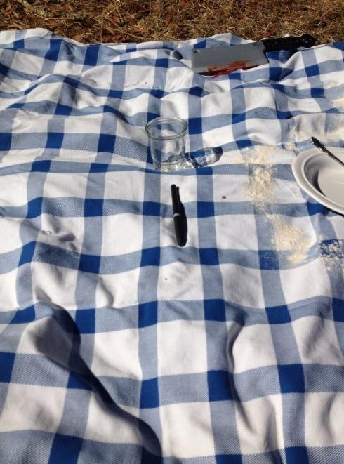
Evidence From the Crime Scene
Human hair
Two blood samples
Knife
Blanket/quilt
Bowls
A marker
A fingerprint from the pen
A death threat sign (Later)

Slide 3
The Hair Analysis
At the Crime scene detectives identified a human hair not belonging to the victim, after ruling out other types of hair. This was our first step in solving our case.

Slide 4
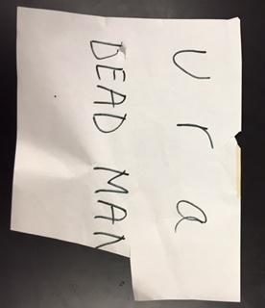
Chromatography Analysis
In our experiment we had to determine the owner of the pen and which pen it was. We found out that the pen was a Crayola marker that wrote the death threat. To do this, we put three dots of three different pens and dabbed them in isopropyl alcohol and matched it with the sample from the crime scene. In the picture above the lighter blue one is the culprit.

Slide 5
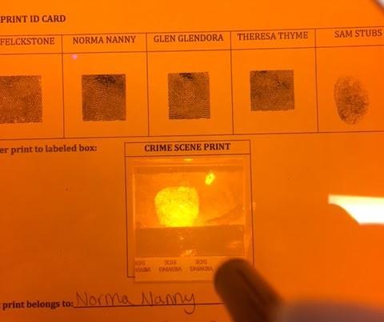
Fingerprint Analysis
As it is hard to see, we identified this fingerprint from the Crayola Marker from the crime scene as Norma Nanny. We can assume even from this that Norma Nanny became a primary suspect.

Slide 6
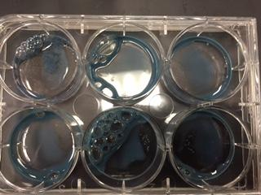
Blood Type Analysis
Detectives also found two blood samples from the crime scene. This crucial piece of evidence we found to possibly trace to Theresa Thyme and Norma Nanny with the crime scene 2 - A blood type and Captain Cornball to the source of the crime scene 1 - O blood type.
With our previous evidence we concluded that the blood belonged to Norma Nanny from assumptions of struggle from the victim, leaving a source of blood.

Slide 7
Norma Nanny’s Family Pedigree
Greg Nanny (A)
Kathy Nanny (B)
Nina Nanny(AB)(H)
Nancy Nanny(O)
Thomas Sandstone
Tony Stubs (H)
Nadia Sandstone
Norma Nanny

Slide 8
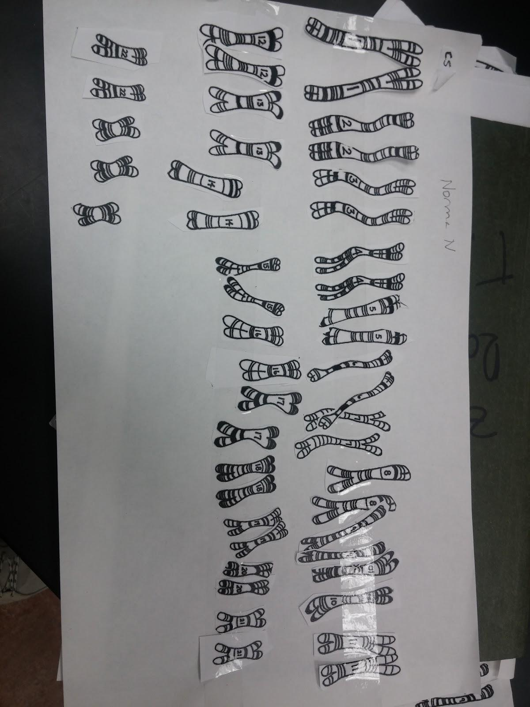
Karyotypes of Norma Nanny
Norma Nanny has the chromosome disorder of Trisomy X or Triple X disease. This disease has effects of learning disabilities and delayed development of speech and language. Behavior and emotional issues are also common. We think this factor can be used to help convict our subject with her motive

Slide 9
Possible Motives of Murder
-Anger, possible mis-identification
-Anger towards Thomas sandstone
-Trisomy X side effects ones emotions
-Captain Cornball was traced to Thomas Sandstone being part of her family tree, could have had a problem with him and his multiple sexual partners

Slide 10
Summary
The pen that wrote the death threat belongs to Norma Nanny
Norma Nanny’s blood sample was found at the scene
Norma Nanny has Trisomy X which can affect her behavior
We would like to arrest Norma Nanny for murder of captain cornbal in the 1st degree

Slide 11
Thank you for listening!

